Slide 1
Final Report Finding a Best Place in Toronto for a new grocery store

Slide 2
Introduction
In this project I want to explore the possible neighborhoods for a grocery store in the city of Toronto. Entrepreneurs of small businesses like grocery stores will have to pay attention to competition.
The location should be sufficient to meet the needs of a grocery store designed by an entrepreneur.

Slide 3
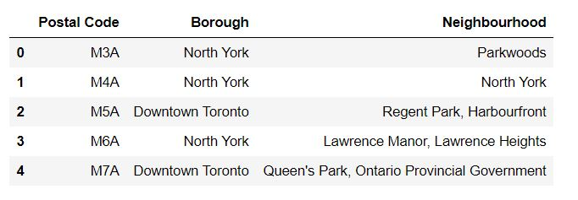
Will use the list of postal codes of Toronto that we used in week 3
Link of the data: https://en.wikipedia.org/wiki/List_of_postal_codes_of_Canada:_M

Slide 4

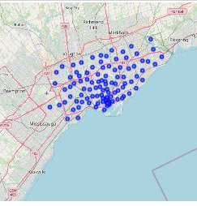
In order to get the required information, we will use "Foursquare" locational information.
The final data frame which will be used in this study contains columns with following information:
Neighborhood
Neighborhood Latitude
Neighborhood Longitude
Venue
Venue Latitude
Venue Longitude
Venue Category

Slide 5
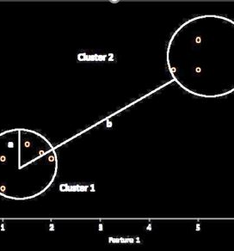
In this project I want to anlayze the possible locations for a grocery store using clustering algorithms such as k-means. The features that i am going to use are longitude and latitude of previous stores in different locations.
In order to find the appropriate number of clusters I will use Silhouette score. Silhouette can be used to validate the consistency between resulting clusters of data. Silhouette score works using the average distance between points within cluster and the other cluster.

Slide 6
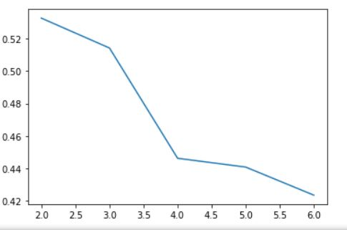
Silhouette score for different values of K is shown in this figure:

Slide 7
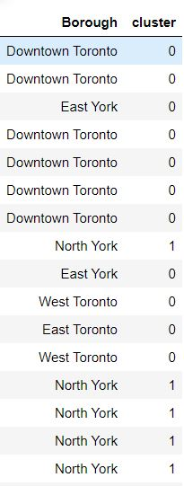
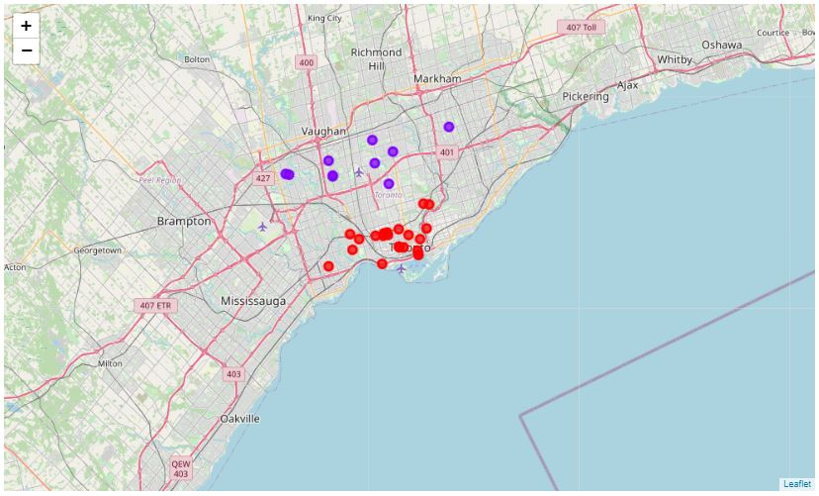
Clusters of the grocery stores based on their location

Slide 8
Discussion
The purpose of this project, is to suggest a better neighborhood in the city of Toronto to start a new grocery store. We examined the different boroughs based on the location of the grocery stores which already exist. We found that there are two clusters of grocery stores in the city of Toronto. One cluster is around the North York and the other one is around Downtown Toronto.
Conclusion
In this project I used Silhouette score to find the optimum number of clusters which was two based on the data that I analyzed. As I mentioned before I found two important boroughs in the city of Toronto according. Based on the number of grocery stores in each borough, I conclude that North York is a better option to open up a new grocery store, since there are large number of stores in downton Toronto.

